Slide 1
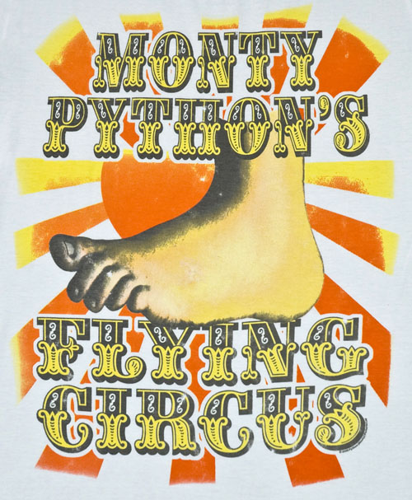
FIT1045 Introduction to Algorithms and Programming Lecture 2 Introduction to Python
COMMONWEALTH OF AUSTRALIA
Copyright Regulations 1969
WARNING
This material has been reproduced and communicated to you by or on behalf of Monash University pursuant to Part VB of the Copyright Act 1968 (the Act).The material in this communication may be subject to copyright under the Act.Any further reproduction or communication of this material by you may be the subject of copyright protection under the Act.
Do not remove this notice.

Slide 2
Objectives of this lecture
To learn a little bit about Python.
To start becoming familiar with Python code.
Notes:
25/07/2016
2

Slide 3
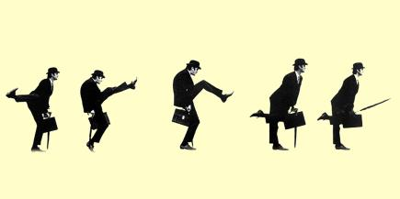
Python
We will use Python to implement the algorithms.
We will use Python to implement the data structures.
Disclaimer: I am NOT a Python expert.

Slide 4
Why Python
General purpose
Very popular with many libraries
Very easy to program
Has depth if you need it
Multi-paradigm: OO, functional, and imperative
Associated programming concepts: objects, higher order, etc
Notes:
As long as you do not have to directly access the computer’s hardwarde, you should be fine.

Slide 5
What version of Python?
Python was created by Guido van Rossum in 1990
It is derived from several other languages, e.g. , Algol-68, Modula, C, C++, SmallTalk, etc.
Python 3 was released in 2008
Backward incompatible!
Which one to choose for FIT1045? 2? 3? 2.x? 3.x?
Pros:
Python 3 is a better language
Is the future
Cons:
Less libraries
Not the default in many systems
We go with the future (will be the past once you are working!)
Version 3.3 or 3.5 are the ones we have chosen

Slide 6
Interactive mode
Python can be run interactively.
You can simply type in commands
Python 3.5.1 (v3.5.1:37a07cee5969, Dec 5 2015, 21:12:44)
[GCC 4.2.1 (Apple Inc. build 5666) (dot 3)] on darwin
Type "copyright", "credits" or "license()" for more information.
>>> WARNING: The version of Tcl/Tk (8.5.9) in use may be unstable.
Visit http://www.python.org/download/mac/tcltk/ for current information.
Prompt
>>> 5000*157.5*360/(31.2 - 24)
39375000.00000001
No special character required at the end of lines
Command evaluated

Slide 7
Arithmetic operators
Operation | Description
x + y | Sum
x - y | Difference
x * y | Product
x / y | Division
x // y | Integer division
x % y | Remainder
-x | Negative
abs(x) | Absolute value
x ** y | Power
>>> 10 // 3
3
>>> 10 % 3
1
>>> 10**3
1000
>>> 3**300
136891479058588375991326027382088315966463695625337436471480190078368997177499076593800206155688941388250484440597994042813512732765695774566001
Integers can be as big as memory allows

Slide 8
Operator Precedence https://docs.python.org/3/reference/expressions.html Section 6.16
From Lowest to Highest Precedence. Operators in same row– group left to right
(except for ** that groups right to left)
Operation | Description
+, - | Addition and subtraction
*, /, //, % | Multiplication, Division, Integer Division, Remainder
** | Exponentiation
3+6*4/2 = 3+24/2=3+12=15

Slide 9
Operator Precedence https://docs.python.org/3/reference/expressions.html Section 6.16
From Lowest to Highest Precedence. Operators in same row– group left to right
(except for ** that groups right to left)
Operation | Description
+, - | Addition and subtraction
*, /, //, % | Multiplication, Division, Integer Division, Remainder
** | Exponentiation
(2**2)**3 = 4**3 = 64

Slide 10
Using MARS
Visit http://mars.mu on your internet enabled device
Log in using your Authcate details (not required if you’re already logged in to Monash)
Touch the + symbol
Enter the code for your unit: ZIETFF
Answer questions when they pop up.

Slide 11
Operator Precedence
MARS QUESTION:
2**2**3+6 = ????
70
A very very big number (2**2**9)
262
None of the above
Operation | Description
+, - | Addition and subtraction
*, /, //, % | Multiplication, Division, Integer Division, Remainder
** | Exponentiation

Slide 12
Computing GST
Compute price including GST.
An example:
Price (excluding GST)
$125
GST
$125*10/100=$12.50
Price (including GST)
$125+$12.50=$137.50

Slide 13
Computing GST
Compute price including GST.
Algorithm:
Price (excluding GST)
Price = $125
GST
GST=Price * 10 /100
Price (including GST)
TotalPrice=Price+GST
Output: TotalPrice

Slide 14
Computing GST
Compute price including GST.
Algorithm:
>>> Price= 125
>>> GST= Price *10/100
>>> TotalPrice = Price + GST
>>> print(TotalPrice)
Price = 125
GST=Price * 10 /100
TotalPrice=Price+GST
Output: TotalPrice

Slide 15

How can you convert AUD$ into Euros?

Slide 16
Currency Convertor
Current value of AUD: E.g. $1 = 0.69 Euro
Amount in AUD: $763.75
Amount in Euros:
>>> dollarValue= 0.69
>>> amountAUD= 763.75
>>> amountEuros= amountAUD* dollarValue
>>> amountEuros
526.9875

Slide 17
Variables
Variables are names for values
Can’t start names with digits, and avoid starting them with underscore.
Names are case sensitive
So price and Price are different variables
Choose meaningful names
No need for the user to declare the type
Python dynamically computes it
Thanks to research on type inference!

Slide 18
Keywords
Do not use the following words as variable names
False | break | else | if | not | try
None | class | except | import | or | while
True | continue | finally | in | pass | with
and | def | for | is | raise | yield
as | del | from | lambda | return
assert | elif | global | nonlocal | str

Slide 19
math module
Function or Constant | Description
sqrt(x) | square root
ceil(x) | smallest integer >= x
floor(x) | largest integer <= x
factorial(x) | x!
cos(x) | cosine
sin(x) | sine
tan(x) | tangent
exp(x) | exponential
log(x) | logarithm
pi | 3.141592653589793
e | 2.718281828459045
Must use import
>>> import math
>>> math.sqrt(2)
1.4142135623730951
>>> math.floor(19.7)
19
Must have math before function name

Slide 20
Strings
Python allows to you to work with strings.
Strings in Python are sequences of characters enclosed by quotes.
Some operations work with strings
>>> s = ‘This is a string: enclosed by single quotes’
>>> t = “This is a another string: double quotes work too”
>>> ch = ‘e’
>>> ‘hello’ + ‘world’
‘helloworld’
>>> 3* ‘hello’
‘hellohellohello’

Slide 21
String Methods
https://docs.python.org/3/library/stdtypes.html#string-methods
4.7.1. String Methods str.capitalize()
Return a copy of the string with its first character capitalized and the rest lowercased.
str.replace(old, new[, count])
Return a copy of the string with all occurrences of substring old replaced by new. If the optional argument count is given, only the first count occurrences are replaced.

Slide 22
Some string methods
>>> s = ‘hello’
>>> len(s)
5
>>> s.upper()
‘HELLO’
>>> s
‘hello’
>>> s.replace(‘lo’, ‘p’)
‘help’
>>> s
‘hello’
>>> t = 3*s.replace(‘lo’, ‘p me now’)
>>> t
‘help me nowhelp me nowhelp me now’
>>> t.count(‘me’)
3
Note: methods do not change the string
Strings are immutable

Slide 23
Input/Output
Prompt is not required but is recommended
Use input to read in a string
String entered
>>> a_str = input(“Enter your string: “)
Enter your name: The lazy dog
>>> print(“Your string with cases swapped is “ + a_str.swapcase())
Your string with cases swapped is tHE LAZY DOG
Prompt
Another string method
Use print for producing output

Slide 24
Type Conversion
int()
Can convert a string to a integer
float()
Can convert a string to a float
str()
Can convert integers and floats to strings

Slide 25
Input/Output Numbers
This is a string
This converts sqr to a string
>>> x = input(“Enter a number: “)
Enter your number: 3.14
>>> x = float(x)
>>> sqr = x*x
>>> print(“The square of your number is “ + str(sqr))
The square of your number is 9.8596
This converts x to a floating
point number

Slide 26
Help
Some sites:
http://www.python.org
http://www.pythontutor.com/
Books
“Introduction to Computing using Python: An Application Development Focus”, by L. Perkovic
https://wiki.python.org/moin/BeginnersGuide/NonProgrammers

Slide 27
Recommended Reading
“Introduction to Computing using Python: An Application Development Focus”, by L. Perkovic
Chapter 5

